Slide 1
Alkenes
Open chained hydrocarbons containing at least one double bond are known as alkenes. The general formula for alkene containing one double bond is C_{n}H_{2n}. The first member of alkene is ethene (CH₂=CH₂) . The double bond is made up of one strong σ bond and one weak π bond. The presence of weak π bond makes alkenes somewhat less stable compounds in comparison to alkanes.

Slide 2
Naming Alkenes
Alkenes are named using a series of rules similar to those for alkanes, with the suffix -ene used instead of -ane to identify the functional group. There are three steps to this process.
Name the parent hydrocarbon. Find the longest carbon chain containing the double bond, and name the compound accordingly, using the suffix -ene:
Number the carbon atoms in the chain. Begin at the end nearer the double bond
Write the full name. Number the substituents according to their positions in the chain, and list them alphabetically. Indicate the position of the double bond by giving the number of the first alkene carbon and placing that number directly before the parent name.

Slide 3
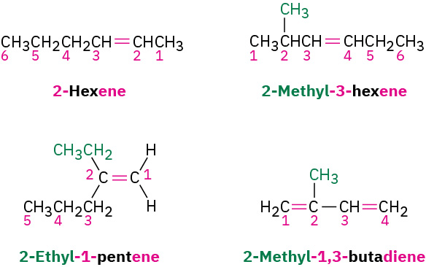
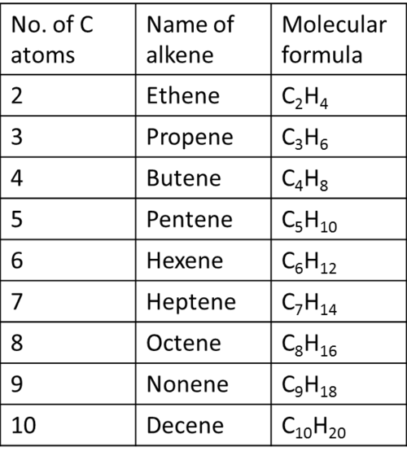

Slide 4
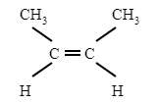
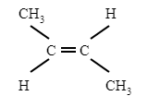
Isomerism in Alkenes
Ethene and propene have only one structure. Alkenes higher than propene have different structures.
cis-isomer
trans-isomer

Slide 5
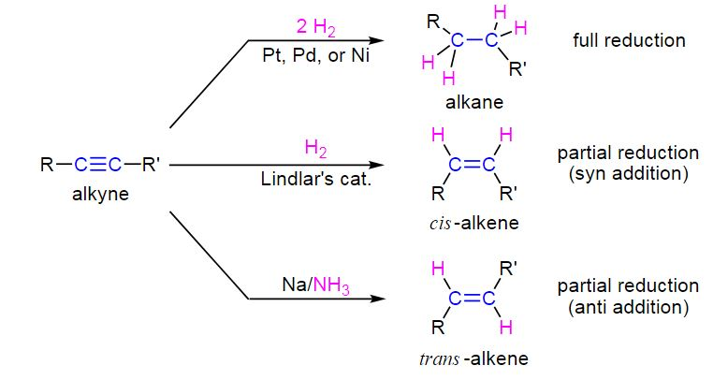
Preparation of Alkenes
Preparation of Alkenes by Partial Reduction
Alkynes can undergo reductive hydrogenation reactions similar to alkenes. With the presence of two pi bonds within alkynes, the reduction reactions can be partial to form an alkene or coplete to form an alkane.

Slide 6
Preparation of Alkenes
Preparation of Alkenes from Alkyl Halides
Haloalkanes, also known as alkyl halides, on heating with a strong base such as alcoholic solution of potassium hydroxide eliminate one molecule of halogen acid (HCl, HBr or HI) to form alkenes. This reaction is known as dehydrohalogenation.

Slide 7
Preparation of Alkenes
Preparation of Alkenes from Alcohols
Alcohols containing a β-hydrogen on heating with concentrated sulphuric acid (H2SO4) lose a molecule of water to form alkenes. Due to the elimination of water and use of acid, this reaction is known as acidic dehydration of alcohols.

Slide 8
Physical Properties of Alkenes
Boiling Points of Alkenes
The boiling point increases as the size increases.
the boiling point decreases with increase in branch.
cis-alkenes have higher boiling points than the corresponding trans-isomers
Solubility of Alkenes
Alkenes being either non-polar or weakly polar molecules are insoluble in water and other polar solvents but are fairly soluble in non-polar solvents such as benzene, CCl4, petroleum ether.

Slide 9
Reactions of Alkenes
Addition of Halogens to Alkenes
When halogens such as bromine, chlorine are added to alkenes, vicinal dihalides are formed.
Iodine does not show addition reaction under normal conditions

Slide 10
Reactions of Alkenes
Bromine test
The addition of bromine to unsaturated compounds in an organic solvent such as CCl4 results in the disappearance of reddish-orange colour of bromine. Because of this reason, this reaction is used to test unsaturation.

Slide 11
Reactions of Alkenes
Addition of hydrogen halides to Alkenes
The addition of hydrogen halides (HCl, HBr, HI) to alkenes yields alkyl halides (haloalkanes). The order of reactivity of the hydrogen halides is HCl > HBr > HI.

Slide 12
Reactions of Alkenes
Addition of Water to Alkenes
Alkenes react with water in the presence of mineral acids to form alcohols in accordance with the Markonikov's rule.

Slide 13
Alkyne
Hydrocarbons containing at least one triple bond are known as alkynes. The triple bond contains one σ bond and two π-bonds. The general formula for alkynes having only one triple bond is CnH2n-2. The first stable member of alkyne is ethyne which is also known as acetylene.

Slide 14
Preparation of Alkynes
Preparation of Alkynes from Calcium Carbide
Ethyne is prepared by treating calcium carbide (CaC2) with water.

Slide 15
Reactions of Alkynes
Addition of Dihydrogen to Alkynes
hen dihydrogen (H2) is added to alkynes in the presence of catalysts such as Pt, Pd or Ni, alkenes are first formed which react further with another molecule of dihydrogen to form alkanes.

Slide 16
Reactions of Alkynes
Addition of Halogens to Alkynes
The addition of halogens (chlorine and bromine) to alkynes is as follows :

